Slide 1
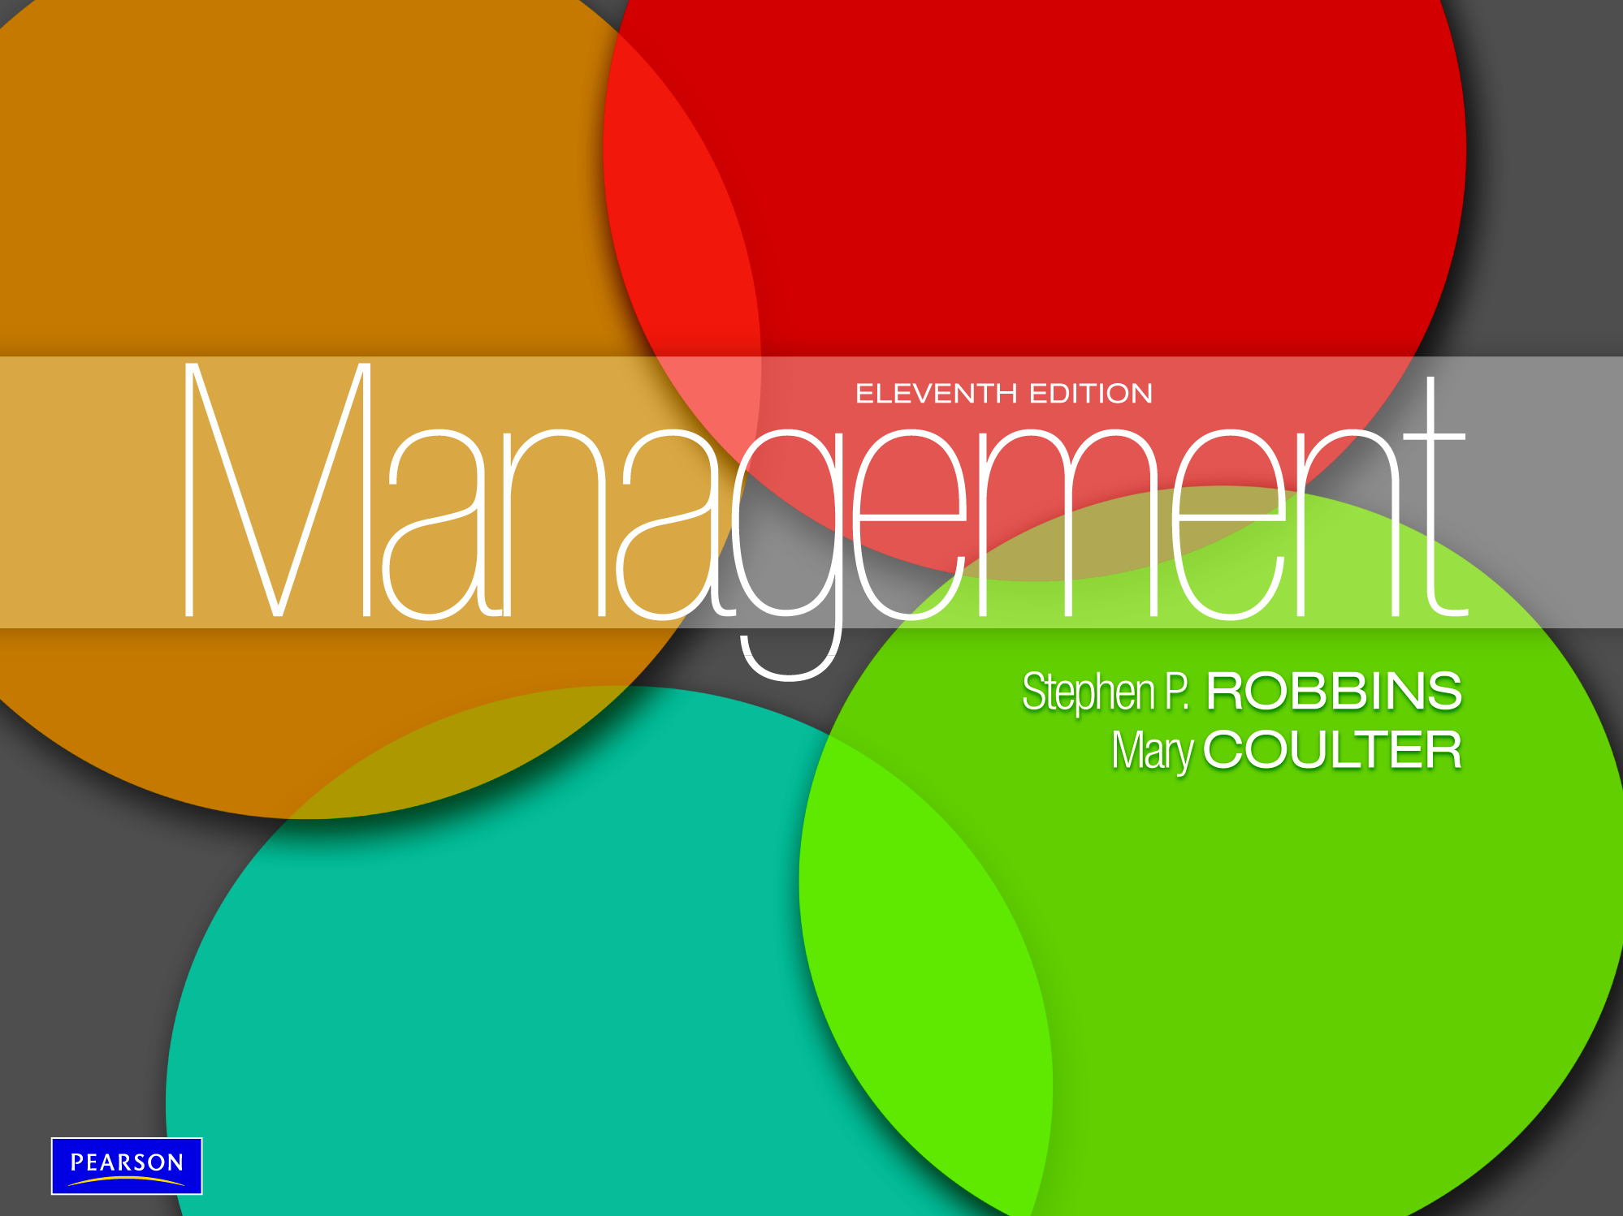

Slide 2

Define strategic management and explain why it’s important
Explain what managers do during the six steps of the strategic management process
Describe the three types of corporate strategies
Describe competitive advantage and the competitive strategies organizations use to get it
Discuss current strategic management issues

Slide 3
What Is Strategic Management?
Strategic management - what managers do to develop the organization’s strategies.
Strategies - the plans for how the organization will do what it’s in business to do, how it will compete successfully, and how it will attract and satisfy its customers in order to achieve its goals.
Business model - how a company is going to make money.

Slide 4
Why Is Strategic
Management Important?
It results in higher organizational performance. (it can make a difference in how well an organization performs).
Managers in organizations of all types and sizes face continually changing situations, they cope with this uncertainty by using the strategic management process to examine relevant factors and decide what actions to take.
organizations are complex and diverse. Each part needs to work together toward achieving the organization’s goals; strategic management helps do this.

Slide 5

Why Is Strategic
Management Important?
Its a game plan that guide a company as it strives to accomplish its mission, goals, and objectives, and to keep it on its desired course.

Slide 6
What is the Strategic
Management Process?
Strategic management process - a six-step process that encompasses strategic planning, implementation, and evaluation.

Slide 7
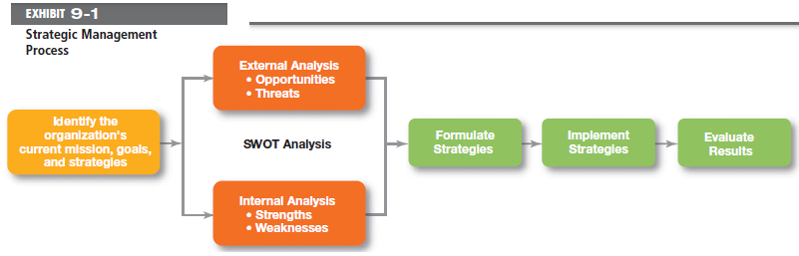
Exhibit 9-1: Strategic
Management Process
Notes:
The strategic management process (see Exhibit 9-1) is a six-step process that encompasses strategy planning, implementation, and evaluation.

Slide 8
Strategic Management Process
Step 1: Identifying the organization’s current mission, goals, and strategies
  Mission: a statement of the purpose of an organization
    The scope of its products and services
  Goals: the foundation for further planning
    Measurable performance targets
Step 2: Doing an external analysis
  The environmental scanning of specific and general environments
    Focuses on identifying opportunities and threats

Slide 9
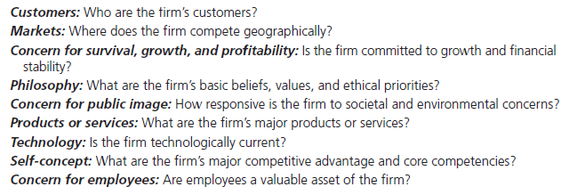
Exhibit 9-2: Components of a
Mission Statement
Notes:
Mission statements provide clues to what organizations see as their purpose. What should a mission statement include? Exhibit 9-2 describes some typical components.

Slide 10
Strategic Management Process
Step 3: Doing an internal analysis
  Assessing organizational resources, capabilities, and activities:
    Strengths create value for the customer and strengthen the competitive position of the firm.
    Weaknesses can place the firm at a competitive disadvantage.
  Analyzing financial and physical assets is fairly easy, but assessing intangible assets (employee skills, culture, corporate reputation, etc.) isn’t as simple.
Steps 2 and 3 combined are called a SWOT analysis. (Strengths, Weaknesses, Opportunities, and Threats)

Slide 11
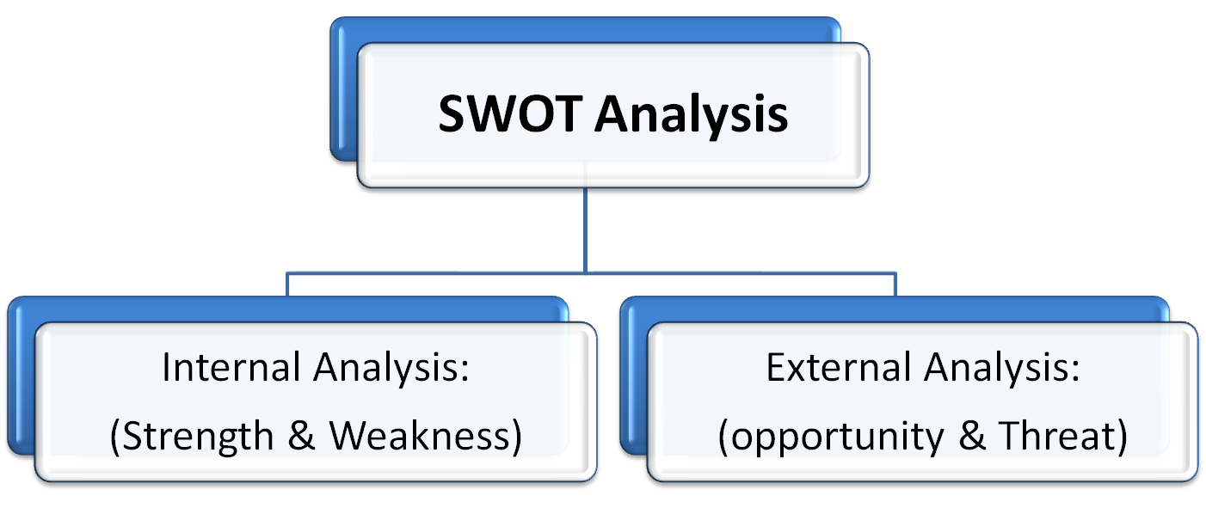
SWOT Analysis
SWOT analysis - an analysis of the organization’s strengths, weaknesses, opportunities, and threats.

Slide 12
Strengths and Weaknesses
Strengths
  Positive internal factors that contribute to accomplishing the mission, goals, and objectives
Weaknesses
  Negative internal factors that inhibit the company’s ability to accomplish its mission, goals, and objectives
Core competencies - the organization’s major value-creating capabilities that determine its competitive weapons.

Slide 13
Opportunity and Threat
Opportunities
  Positive external forces the company can exploit to accomplish its mission, goals, and objectives
Threats
  Negative external forces that inhibit the company’s ability to accomplish its mission, goals, and objectives

Slide 14
Strategic Management Process
Step 4: Formulating strategies
  As managers formulate strategies, they should consider the realities of the external environment and their available resources and capabilities in order to design strategies that will help an organization achieve its goals.
  Three main types of strategies managers will formulate include corporate, competitive, and functional

Slide 15
Strategic Management Process
Step 5: Implementing strategies
  Once strategies are formulated, they must be implemented. No matter how effectively an organization has planned its strategies, performance will suffer if the strategies aren’t implemented properly.
Step 6: Evaluating results
  The final step in the strategic management process is evaluating results. How effective have strategies been? What adjustments, if any, are necessary?

Slide 16
Types of Organizational strategies
Organizations use three types of strategies: corporate, competitive, and functional.
Top-level managers typically are responsible for corporate strategies, middle-level managers for competitive strategies, and lower-level managers for functional strategies.

Slide 17
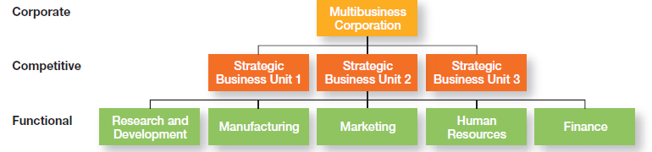
Exhibit 9-3: Types of
Organizational Strategies
Notes:
As we said earlier, organizations use three types of strategies: corporate, competitive, and functional. (See Exhibit 9-3.) Top-level managers typically are responsible for corporate strategies, middle-level managers for competitive strategies, and lower-level managers for functional strategies.

Slide 18
Corporate Strategies
Corporate strategy - an organizational strategy that determines what businesses a company is in or wants to be in, and what it wants to do with those businesses.
Types of Corporate Strategies
    Growth: expansion into new products and markets.
    Stability: maintenance of the status quo.
    Renewal: examination of organizational weaknesses that are leading to performance declines.

Slide 19
Corporate Strategies (cont.)
Growth strategy - a corporate strategy that’s used when an organization wants to expand the number of markets served or products offered, through either its current business(es) or new business(es).
    Concentration
    Integration (horizontal & Vertical)
    Diversification

Slide 20
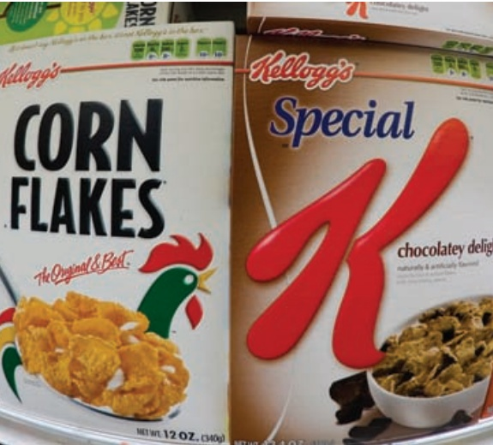
Corporate Strategies (cont.)
Stability strategy - a corporate strategy in which an organization continues to do what it is currently doing.
Renewal strategy - a corporate strategy designed to address declining performance.

Slide 21
How Are Corporate
Strategies Managed?
Strategic Business Unit (SBU) - the single independent businesses of an organization that formulate their own competitive strategies.
BCG matrix - a strategy tool that guides resource allocation decisions on the basis of market share and growth rate of SBUs.

Slide 22
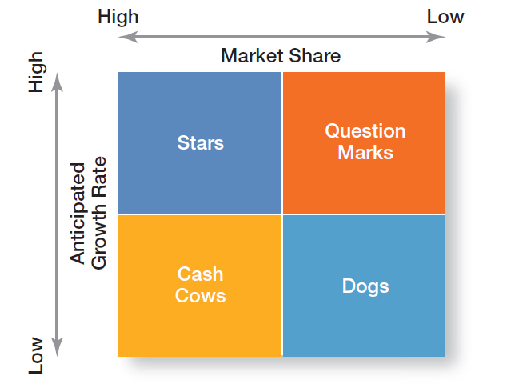
Exhibit 9-4: BCG Matrix
Notes:
The first portfolio matrix—the BCG matrix—was developed by the Boston Consulting Group and introduced the idea that an organization’s various businesses could be evaluated and plotted using a 2 * 2 matrix (see Exhibit 9-4) to identify which ones offered high potential and which were a drain on organizational resources.

Slide 23
Competitive Strategy
Competitive strategy - an organizational strategy for how an organization will compete in its business(es).
The aim of every competitive strategy is earn a Competitive Advantage.

Slide 24
Types of Competitive Strategies
Cost Leadership Strategy
  Seeking to attain the lowest total overall costs relative to other industry competitors
Differentiation Strategy
  Attempting to create a unique and distinctive product or service for which customers will pay a premium
Focus Strategy
  Using a cost or differentiation advantage to exploit a particular market segment as opposed to a larger market

Slide 25
The Role of Competitive Advantage
Competitive advantage - what sets an organization apart; its distinctive edge.
The competitive advantage can be come from:
  Organization’s Core Competence.
  Organization’s unique resource.
  Quality is on of the main sources of competitive advantage.

Slide 26
Sustaining Competitive Advantage
Five Competitive Forces
Threat of New Entrants
  The ease or difficulty with which new competitors can enter an industry
Threat of Substitutes
  The extent to which switching costs and brand loyalty affect the likelihood of customers adopting substitute products and services
Bargaining Power of Buyers
  The degree to which buyers have the market strength to hold sway over and influence competitors in an industry

Slide 27
Five Competitive Forces
Bargaining Power of Suppliers
  The relative number of buyers to suppliers and threats from substitutes and new entrants affect the buyer-supplier relationship.
Current Rivalry
  Intensity among rivals increases when industry growth rates slow, demand falls, and product prices descend.

Slide 28
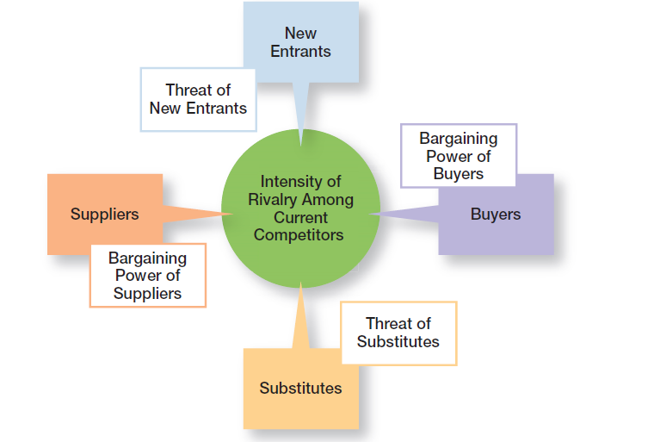
Exhibit 9-5: Five Forces Model
Notes:
In any industry, five competitive forces dictate the rules of competition. Together, these five forces (see Exhibit 9-5) determine industry attractiveness and profitability, which managers assess using these five factors.

Slide 29

What is a Functional Strategy?
Functional strategy - the strategies used by an organization’s various functional departments to support the competitive strategy.

Slide 30
Current Strategic Management Issue
The Need for Strategic Leadership
Strategic leadership - the ability to anticipate, envision, maintain flexibility, think strategically, and work with others in the organization to initiate changes that will create a viable and valuable future for the organization.

Slide 31
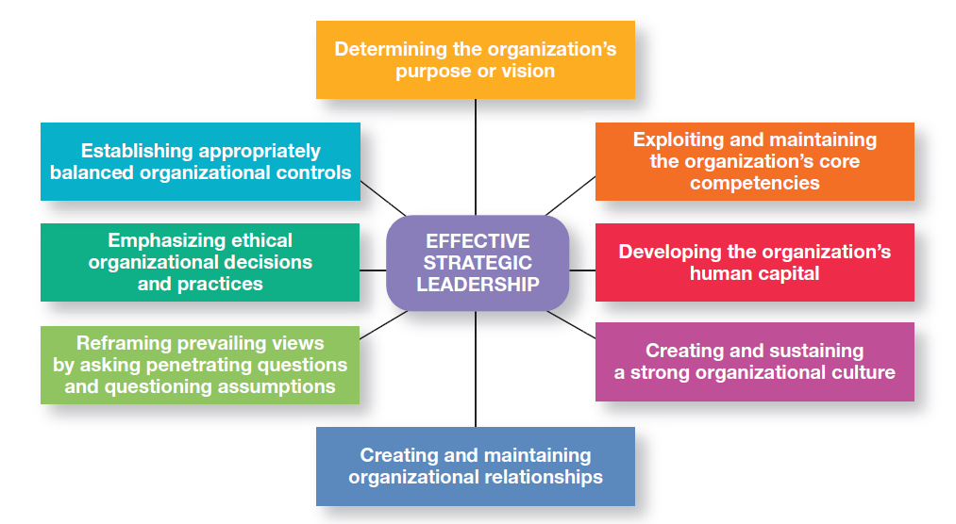
Exhibit 9-6: Effective Strategic Leadership
Notes:
How can top managers provide effective strategic leadership? Eight key dimensions have been identified.28 (See Exhibit 9-6.)

Slide 32
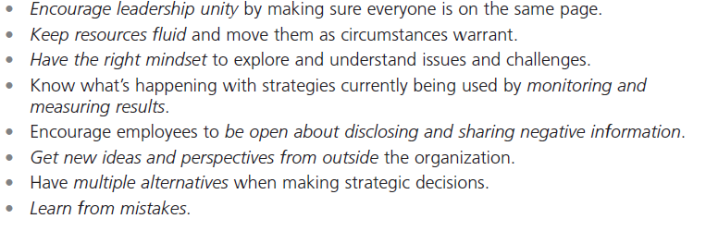
Current Strategic Management Issue Cont….
Strategic flexibility - the ability to recognize major external changes, to quickly commit resources, and to recognize when a strategic decision was a mistake.

Slide 33
Current Strategic Management Issue Cont….
Organizational strategies used for today’s environment
1. e-Business Strategies:
Cost Leadership
  On-line activities: bidding, order processing, inventory control, recruitment and hiring
Differentiation
  Internet-based knowledge systems, online ordering and customer support
Focus
  Chat rooms and discussion boards, targeted Web sites

Slide 34
Organizational strategies used for today’s environment
2. Customer Service Strategies
Giving the customers what they want
Communicating effectively with them
Providing employees with customer service training

Slide 35
Organizational strategies used for today’s environment
3. Innovation Strategies
Strategic Decisions about Innovation
  Basic research
  Product development
  Process innovation
First Mover - an organization that’s first to brings a product innovation to the market or uses new process innovations.

Slide 36
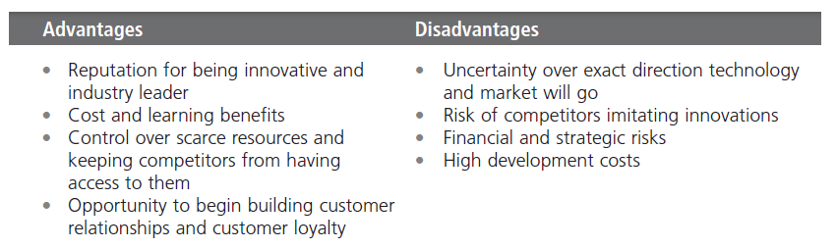
Exhibit 9-8: First-Mover Advantages and Disadvantages
Notes:
An organization that’s first to bring a product innovation to the market or to use a new process innovation is called a first mover. Being a first mover has certain strategic advantages and disadvantages as shown in Exhibit 9-8.

Slide 37
Terms to Know
strategic management
strategies
business model
strategic management process
mission
opportunities
threats
resources
capabilities
core competencies
strengths
weaknesses
SWOT analysis
corporate strategy
growth strategy
stability strategy
renewal strategy
BCG matrix
competitive strategy
strategic business units
competitive advantage
functional strategies
strategic flexibility
first mover

Slide 38
